Slide 1
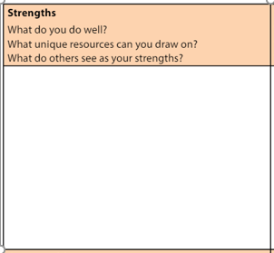
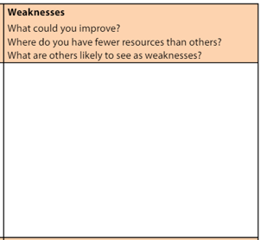
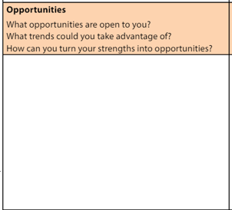
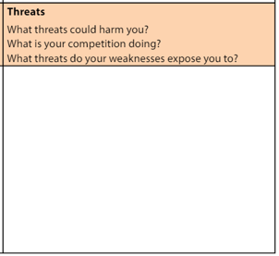
Notes:
4 huge sticky notes each as a S, W, O, or T
Imagine each of you has normal sized sticky notes – One thought per note
Everyone places their notes where they belong
Then we condense, remove duplicates, and refine the sticky notes into common themes

Slide 2
Theme 1 Theme 2 Theme 3 Theme 4
Theme 1 Theme 2 Theme 3
Theme 1 Theme 2 Theme 3 Theme 4
Theme 1 Theme 2 Theme 3 Theme 4
Notes:
4 huge sticky notes each as a S, W, O, or T
Imagine each of you has normal sized sticky notes – One thought per note
Everyone places their notes where they belong
Then we condense, remove duplicates, and refine the sticky notes into common themes

Slide 3
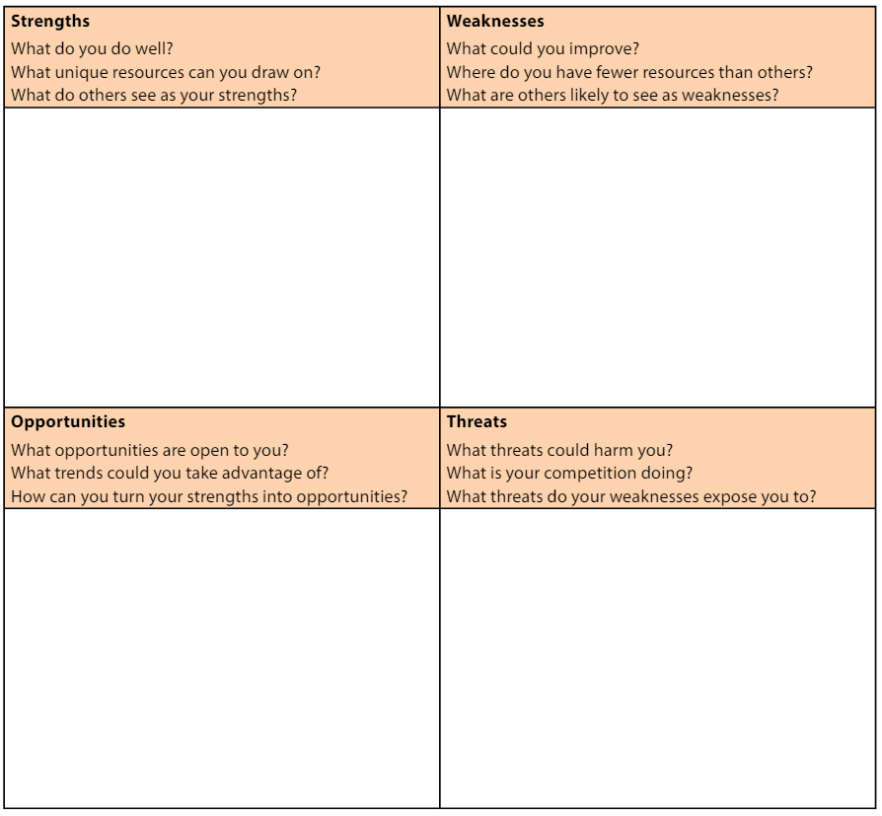
Notes:
A recorder for the group listens to each S.W.O.or T report out their common themes and records those on the common SWOT

Slide 4
Notes:
So, here is a common SWOT with the themes from each of the S-W-O-T pages
Here is an example of some these which might grow from the sticky notes
Now, in relation to YOUR particular office, Please take a moment and add two thoughts to each section SWOT
Let’s pretend that the items on your SWOT represent the consolidation of everyone’s sticky notes into themes,
It is important to understand that at this point everyone has contributed their ideas and is a part of this process
We will now move to the TOWS analysis to create strategy

